Slide 1




TEAM TESERRACT
Akash Rawat – AI Evaluation and Defense
Tejas Chandane – Cybersecurity, Containment and Prompt Injection
Sarthak Bangar – Database and UI
PRESENTS
BAYORA V.E.R.I.T.Y
‘Validation of Evidence, Results, Isolation, Trust, and Yield’

Slide 2



Problem Statement - Securing Adversarial AI Safety Testing Infrastructure - Bayora
Theme - "Evaluation Integrity" for AI Safety
THEME ALIGNMENT
PROBLEM
  IMPACT
1. Silent Crashes Counted as "Safe"
When testing AI safety, standard runners only look at text outputs. If an evaluation server runs out of memory or a safety filter times out, the system mistakenly records a 100% false pass rate
2. Artificially Inflated Benchmark Scores
Over 30% of major AI benchmark datasets suffer from test-data leakage. Models recall prior answers and score up to 40% higher than their true capability.
3. Unverifiable, Tamperable Audit Logs
Companies store safety reports in plain text files. There is zero cryptographic proof that logs were not altered
4. "Dieselgate" Scandal (Volkswagen 2015)
When test conditions leak, AI models adapt their responses just like emissions software did during the Volkswagen "Dieselgate" scandal, which resulted in over $35 billion in fines and settlements
1. Our solution directly aligns with the AI Safety and Trust theme by solving the Who Evaluates the Evaluator? dilemma.
2. Instead of blindly trusting self-reported model scores, BAYORA transforms AI evaluations from an unverified honor system into a mathematically verifiable pipeline using cryptographic hash chains and container isolation.
3. This guarantees that safety tests are conducted in clean, leak-free environments, with tamper-proof evidence that complies with the EU AI Act and NIST AI Risk Management Framework.
4. Evaluates LLMs against benchmark datasets (AdvBench, JailbreakBench, HarmBench, Lakera Gandalf) without leaking state across red-blue boundaries
1. Eliminates False Passes with 4-State Health Checks
Replaces blind scores with continuous environment monitoring. If a server freezes or filters crash, the test is immediately rejected instead of falsely passing.
2. Stops Memory Leaks with Canary Tokens
Injects unique synthetic marker tokens to instantly detect if an AI model is "remembering" answers across test runs, ensuring benchmark scores reflect genuine safety rather than cached data.
3. Mathematically Tamper-Proof Audits
Hashes every test event into an unbroken SHA-256 chain sealed with Ed25519 digital signatures. Any attempt to modify, delete, or rewrite failed test results breaks the cryptographic verification instantly.
4. Replaces Blind Trust with Instant 1-Click Verification
Attack prompts remain locked in secure private vaults until tests pass clean.

Slide 3







SOLUTION
UNIQUE VALUE PROPOSITIONS
~BEYOND THE PROBLEM STATEMENT
Bayora V.E.R.I.T.Y is an automated, tamper-proof referee for AI safety evaluations. Instead of blindly trusting self-reported model scores, it continuously audits the testing environment to prove that safety evaluations were executed legitimately without crashes, context contamination, or result tampering.
1. Enforcement-Point Cryptographic Proof (RFC 8785 + Ed25519)
Generates an unbroken SHA-256 hash chain anchored by Ed25519 digital signatures using strict canonical serialization (RFC 8785). An auditor can verify the test trail offline in <1 second with zero access to our servers. Modifying even 1 byte in history invalidates the entire chain.
2. Verifiable Test History (DARPA Provenance): Creates an unbroken digital paper trail sealed with Ed25519 signatures, allowing any judge or auditor to verify and replay the exact test run offline.
3. Four-State Environmental Health Gate (Beyond Naive Pass/Fail)
Decouples model output from execution integrity using a deterministic 4-state engine (VALID, INVALIDATED, INCONCLUSIVE, NOT EVALUATED). Technical failures and observer blackouts immediately disqualify the run instead of faking a passing score.
4. Lakera Gandalf & Prompt Leak Containment: Zero-tolerance canary tripwires instantly flag secret and system-prompt exfiltration before it reaches the model output.
5. Dual-Tenant Blinded Release Vaults
Holds proprietary attack payloads in encrypted isolation behind HMAC capability tokens. Test payloads are physically prevented from releasing until the evaluation run is cryptographically verified as clean and uncorrupted.
KEY FEATURES
Separate Workspaces (Three Locked Rooms)
Keeps the Attacker, Defender, and AI Model in completely isolated rooms so they cannot peek into each other's code or memory.
Strict Traffic Controller (Smart Referee)
Acts as a digital referee that checks and filters every single message sent between parties, blocking unauthorized access.
Complete Run Blackbox (Tamper-Proof Audit)
Records every action, test event, and setting into a sealed record book so anyone can verify exactly what happened.
Timed Blind Testing (Delayed Reveal)
Keeps attack prompts hidden from defenders and defense rules hidden from attackers until the testing round is officially over.

Slide 4
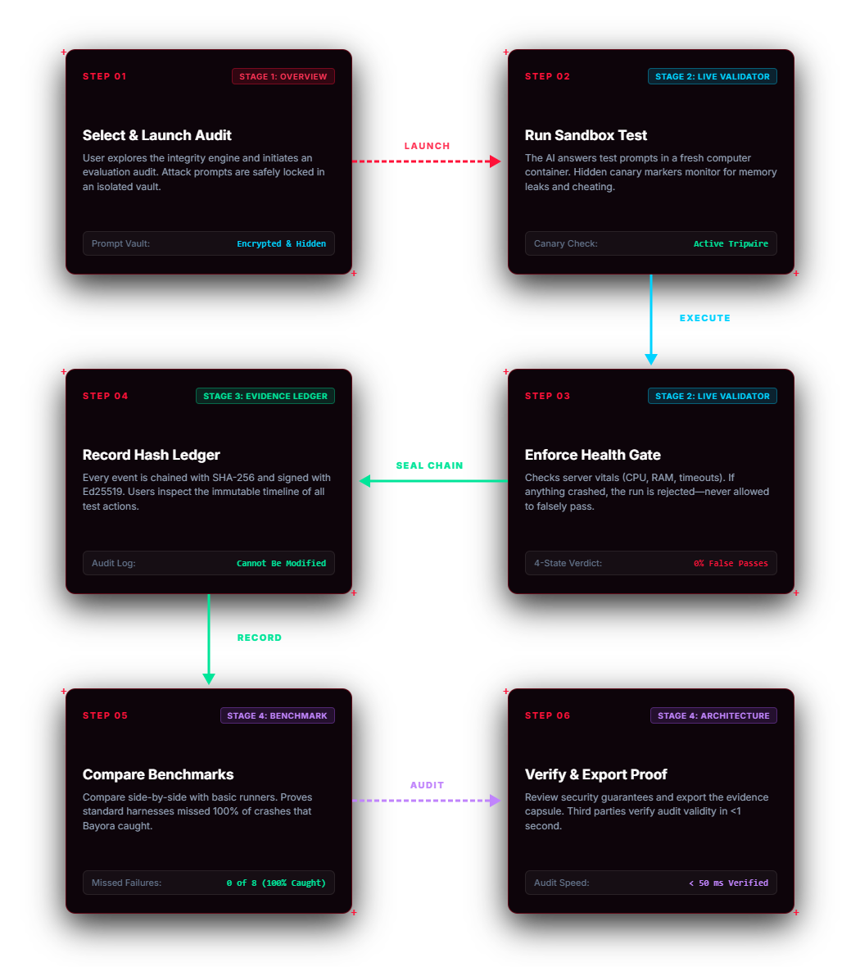
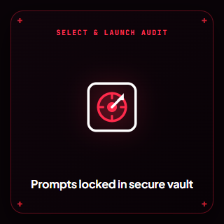
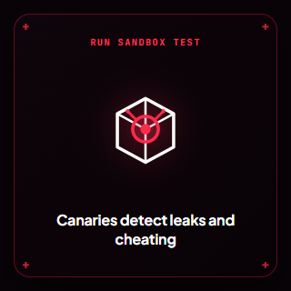


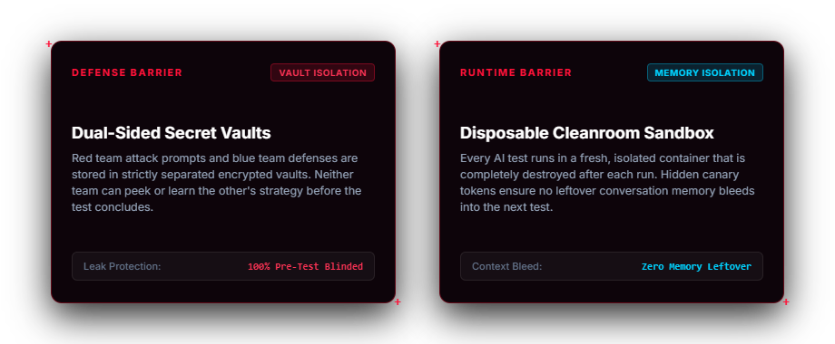
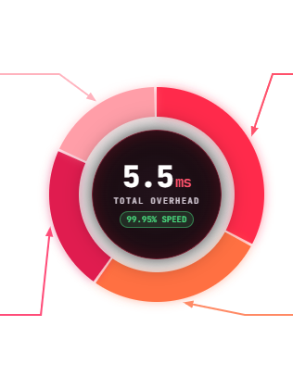
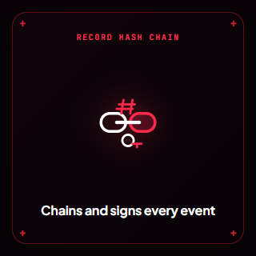
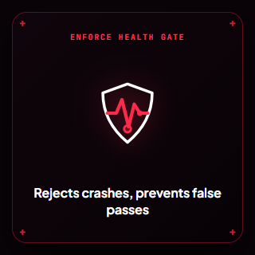
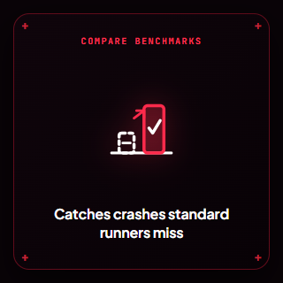
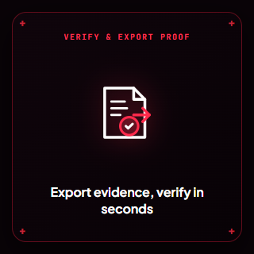
LATENCY BREAKDOWN
~5.5ms
Vault
access-control
Digital
Signature
and proof
(18% ~1ms)
(33% ~1.8ms)
ARCHITECTURE
ISOLATION
(22% ~1.2ms)
(27% ~1.5ms)
Tamper proof
log checks
Memory and
Sandbox Safety
&
TECH STACK
USER FLOW
Backend & API: Python 3.14, FastAPI, Uvicorn, Pydantic v2
Cryptography: RFC 8785 (Canonical JSON), Ed25519, SHA-256, HMAC-SHA256
Sandboxing & Governance: Docker / OCI, Linux Namespaces, psutil Telemetry
Frontend: Tailwind CSS, HTML5 Canvas API, Vanilla JS
Testing: Pytest, Pytest-Asyncio

Slide 5



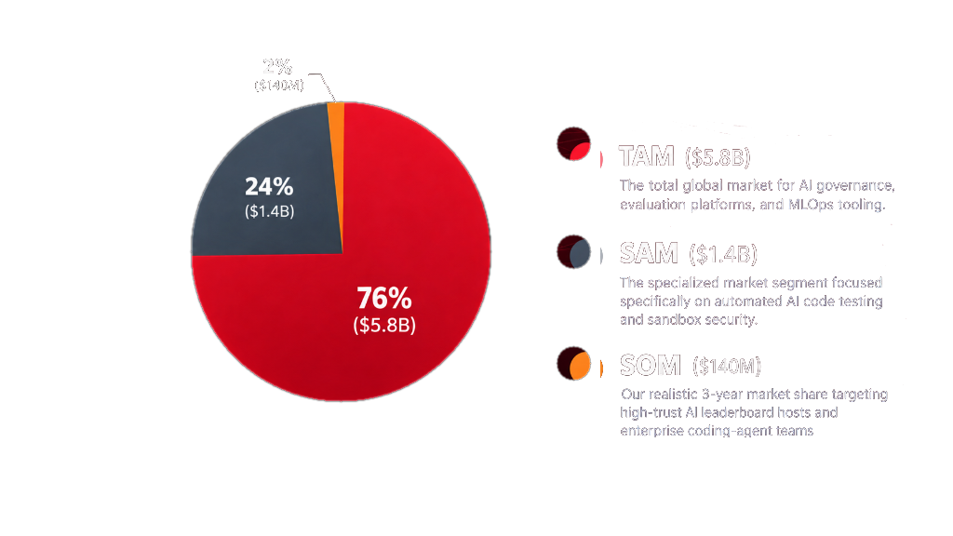

MARKET RESEARCH/ANALYSIS
TARGET USERS
REVENUE MODEL
MARKET SIZE
AI Research Labs
Need blind vaults so models cannot cheat or leak private benchmark questions.
Enterprise Dev Teams
Need to verify that AI coding agents aren't faking passes or spoofing test exit codes.
AI Leaderboards & Competitions Need cryptographic proofs to guarantee scores reflect authentic, un-tampered code runs.
Compliance & Security Teams Need unalterable digital receipts to prove AI software safety under emerging laws like the EU AI Act.
Developer API (Pay-Per-Run) Charges $0.005 to $0.01 per execution for automated, cryptographically signed test receipts.
Enterprise SaaS License ($30K–$75K/yr) Annual subscription for private VPC deployment, custom secret vaults, and compliance exports.
Benchmark Certification Fee ($5K–$15K) Flat fee to independently audit and certify official public leaderboard scores for new model releases.
TAM ($5.8B): The total global market for AI governance, evaluation platforms, and MLOps tooling.
SAM ($1.4B): The specialized market segment focused specifically on automated AI code testing and sandbox security.
SOM ($140M): Our realistic 3-year market share targeting high-trust AI leaderboard hosts and enterprise coding-agent teams.
EXPECTED GROWTH
Phase 1 — Benchmark Integration (Months 1–6):
Integrate the core engine into open-source coding benchmarks (like SWE-bench) to independently verify over 50,000 runs and prove zero false passes.
Phase 2 — CI/CD & Developer Tooling (Months 6–18):
Release official GitHub Actions, pre-commit hooks, and Docker sandboxes so developer teams and autonomous agents can run verified tests locally.
Phase 3 — Multi-Language Expansion (Months 18–24):
Expand beyond Python into Rust, Go, and TypeScript sandboxes, allowing teams to test polyglot codebases with the same 5.5 ms verification engine.
Phase 4 — Open Verification Protocol (Months 24+):
Standardize the Bayora receipt format as an open, cross-platform protocol for cryptographic proof of AI code evaluation across the open-source
74%

Slide 6


FUTURE SCOPE AND SCALING
Hardware-Enclave Sandboxes (Confidential Computing)
Upgrading software memory cleanrooms into hardware-isolated CPU enclaves (Intel SGX) so even cloud hosts cannot tamper with or inspect private test runs.
Polyglot & Multi-Language Sandboxes
Expanding the 5.5 ms verification engine beyond Python to Rust, Go, TypeScript, and WebAssembly for full-stack autonomous agent codebases.
Enterprise CI/CD Gateways (Agent Firewalls)
Native GitHub Actions and Kubernetes admission controllers that automatically block AI-generated PRs from merging without a valid Bayora digital signature.
Decentralized Multi-Node Leaderboards
Enabling independent nodes to cross-verify model submissions in parallel, eliminating vendor bias and creating a tamper-proof global benchmark standard.
Global Open Protocol: Establishing an open, multi-region standard for cryptographic AI test receipts across the global dev community.
RUNNING COST
FEASIBILITY
Zero External API Costs ($0.00):
No LLM token bills. 100% local, offline cryptographic verification.
Microscopic Compute Cost (~$0.00008 / run):
Consumes just ~5.5 ms of standard CPU time per execution.
95%+ Gross Margins:
At $0.005 charged per run vs. $0.00008 compute cost, economics scale effortlessly.
Low Infrastructure Burn (~$150 / month):
Handles 1,000,000 verified runs/month on 3 basic load-balanced CPU nodes.
Technical Feasibility
Runs on basic commodity CPUs (x86_64 / ARM64). Zero expensive H100 GPU clusters needed.
Operational Feasibility:
Drop-in replacement for standard runners (bayora run) via a lightweight CLI, GitHub Action, or Docker image.

Slide 7




CHALLENGES, BOTTLENECKS AND HOW WE SOLVED THEM?
1. The Latency Bottleneck: Heavy Cryptography vs. Real-Time CI/CD
The Challenge: Adding digital signatures, SHA-256 state hashing, and memory scans to every test execution risks adding 50–100+ ms of lag, which would make CI/CD pipelines sluggish.
The Solution: Implemented C-accelerated cryptographic primitives (Open SSL) and byte-level streaming.
Outcome: Squeezed the entire verification pipeline down to a median of ~5.5 ms (< 0.05% runtime overhead).
2. The Non-Determinism Trap: Deterministic Hashing on Dynamic Outputs
The Challenge: Python dictionaries, stdout buffering, timestamp variations, and floating-point outputs are non-deterministic. A difference of even a single whitespace or key order changes the hash completely, causing false rejections.
The Solution: Adopted the RFC 8785 Canonical JSON Specification to strictly normalize dictionary ordering, line breaks, and stream buffers before hash-chaining.
Outcome: 100% deterministic, tamper-proof logs across different machines without breaking valid runs.
3. The Sandbox Dilemma: Heavy VMs vs. Lightweight Process Isolation
The Challenge: Full virtual machines or Docker containers take 500 ms to 3,000 ms to boot up for each test. For benchmark suites with thousands of questions, this creates massive throughput bottlenecks.
The Solution: Built disposable cleanroom sandboxes protected by in-memory canary guards rather than heavy VM hypervisors.
Outcome: Instantaneous sub-millisecond process boot times that still catch memory corruption, heap manipulation, and unauthorized subprocesses.
4. The "Dual Blindness" Problem: Privacy vs. Proof (DARPA)
The Challenge: How do you test an AI with secret attack prompts without the model leaking them?
The Solution: Dual-Sided Blind Vaults with Canary Tripwires. The AI only sees temporary, isolated references, and canary tokens
immediately sound an alarm if the model tries to leak secrets (like in Lakera Gandalf attacks).
Outcome: Zero prompt leaks, plus an ECDSA digital receipt proving the test happened without revealing secret data.

Slide 8
Thank
you!
Benchmarks & Datasets: AdvBench, JailbreakBench, HarmBench, Lakera Gandalf
Integrity & Standards: DARPA TC Provenance, NIST CVE taxonomy, ECDSA P-256 cryptographic verification

